Slide 1

Tools for the optimal operation
and planning of power systems
Lecture 1: Introduction to operations research
Álvaro García-Cerezo
Power and Energy Analysis and Research Laboratory
School of Industrial and Aerospace Engineering of Toledo, Spain
Universidad de Castilla-La Mancha, Spain

Slide 2
Copyright
© 2026 Álvaro García Cerezo. This document is licensed under a Creative Commons Attribution 4.0 International License (CC BY 4.0).
https://creativecommons.org/licenses/by/4.0/

Slide 3
Contents
Introduction
Classification of Optimization Models
Linear Programming
Mixed Integer-Linear Programming
Nonlinear Programming
Optimization Software
Dual variables
Reformulation Techniques

Slide 4
1. Introduction

Slide 5
Introduction
Optimization

Slide 6
Introduction
To make the best decision

Slide 7
Optimization
What is the best option?

Slide 8
Optimization
It depends

Slide 9
Optimization
To make the best decision
for a given objective function and subject to the
constraints of the problem

Slide 10
Optimization
Objective function:
Minimize the cost / maximize the profit.
Maximize the renewable production.
Minimize the losses of energy.

Slide 11
Optimization
Constraints:
Power balance.
Budget.
Technical limits.
Environmental and political limits.

Slide 12
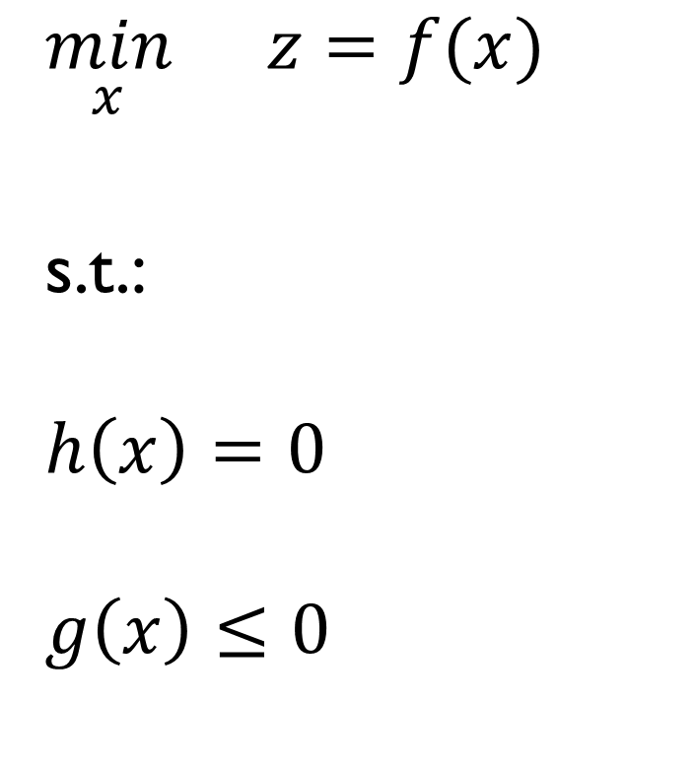
General formulation
$$\min_{x}{}z=f(x)$$
s.t.:
$$h\left(x\right)=0$$
$$g\left(x\right)≤0$$

Slide 13
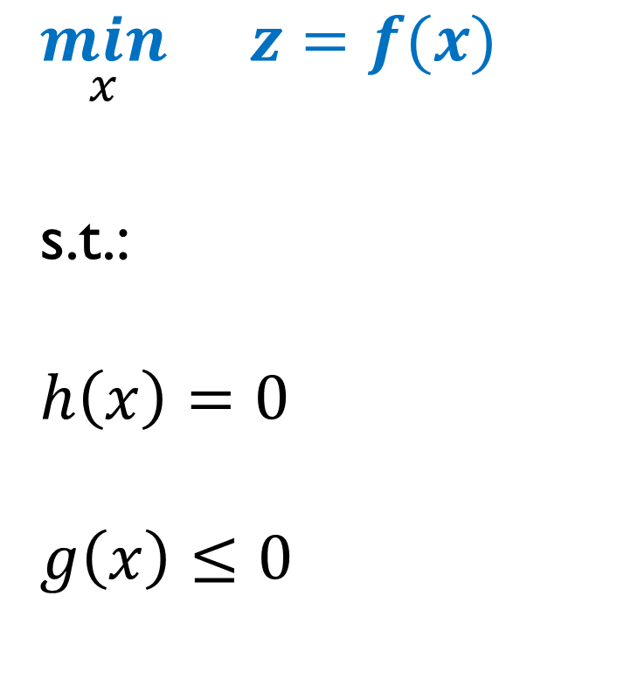
General formulation
$$\min_{x}{}z=f(x)$$
s.t.:
$$h\left(x\right)=0$$
$$g\left(x\right)≤0$$
Objective function

Slide 14
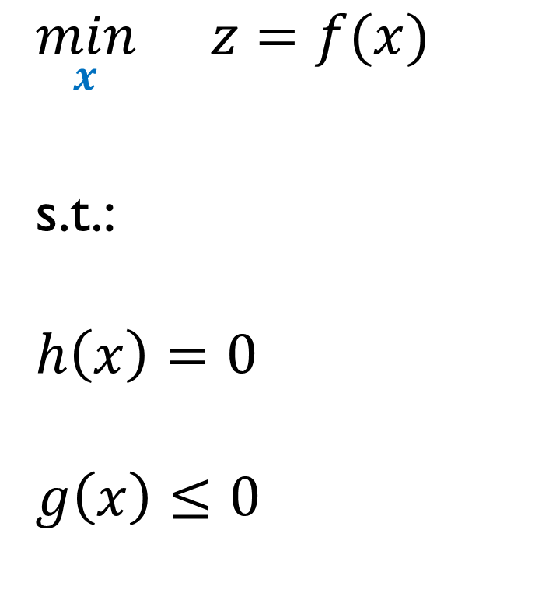
General formulation
$$\min_{x}{}z=f(x)$$
s.t.:
$$h\left(x\right)=0$$
$$g\left(x\right)≤0$$
Variables

Slide 15
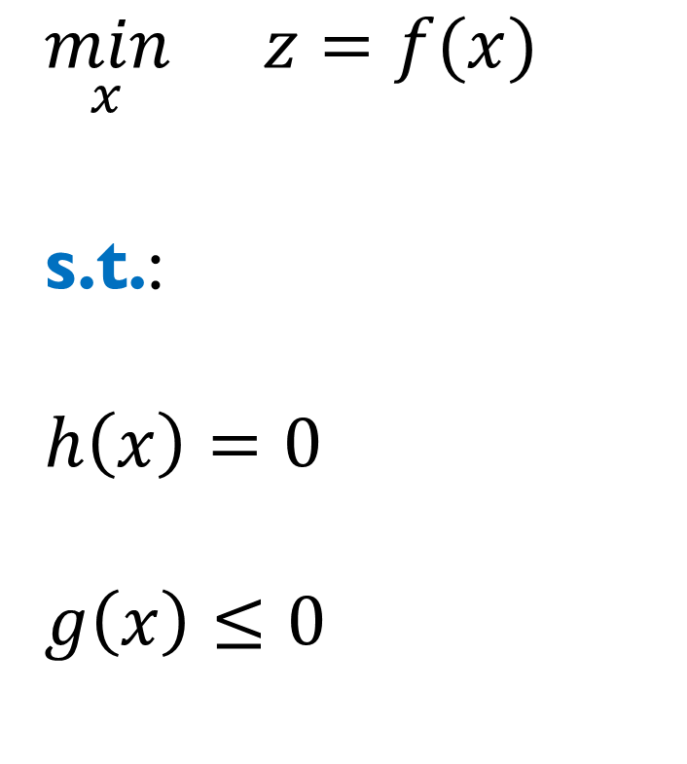
General formulation
$$\min_{x}{}z=f(x)$$
s.t.:
$$h\left(x\right)=0$$
$$g\left(x\right)≤0$$
Subject to

Slide 16
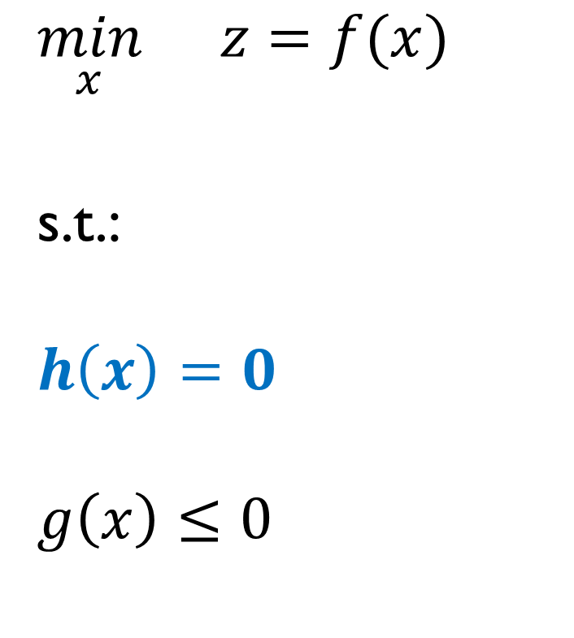
General formulation
$$\min_{x}{}z=f(x)$$
s.t.:
$$h\left(x\right)=0$$
$$g\left(x\right)≤0$$
Equality constraints

Slide 17
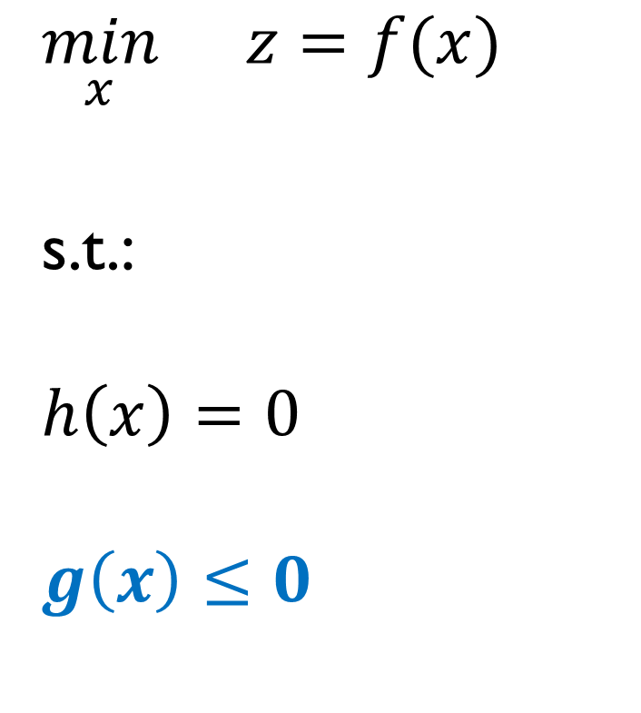
General formulation
$$\min_{x}{}z=f(x)$$
s.t.:
$$h\left(x\right)=0$$
$$g\left(x\right)≤0$$
Inequality constraints

Slide 18
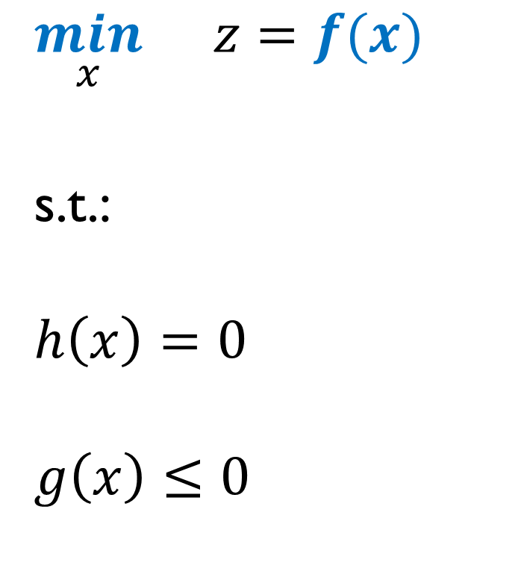
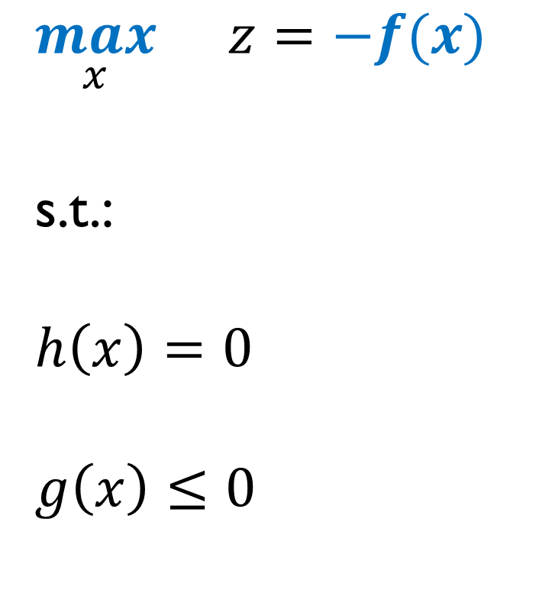
General formulation
$$\min_{x}{}z=f(x)$$
s.t.:
$$h\left(x\right)=0$$
$$g\left(x\right)≤0$$
$$\max_{x}{}z=−f(x)$$
s.t.:
$$h\left(x\right)=0$$
$$g\left(x\right)≤0$$

Slide 19
Applications to Power Systems
Participation in electricity markets.
Security of power systems.
Participation in demand response programs.
Investment in transmission lines, generating units, and storage facilities.

Slide 20
What will you learn?
To classify optimization models.
To solve optimization problems graphically.
To solve optimization problems using computational tools.
To reformulate nonlinear optimization problems.
The meaning of dual variables.

Slide 21
2. Classification of Optimization Models

Slide 22
Classification of optimization problems
What is mathematical optimization?
https://www.youtube.com/watch?v=AM6BY4btj-M

Slide 23
Classification of optimization problems
Model Type | Abbreviation | Terms | Variables
Linear Programming | LP | Linear | Continuous
Mixed-Integer Linear Programming | MILP | Linear | Integer and continuous
Nonlinear Programming | NLP | Nonlinear and linear | Continuous

Slide 24
Classification of optimization problems
There are other types, such as:
Model Type | Abbreviation | Terms | Variables
Mixed-Integer Nonlinear Programming | MINLP | Nonlinear and linear | Integer and continuous

Slide 25
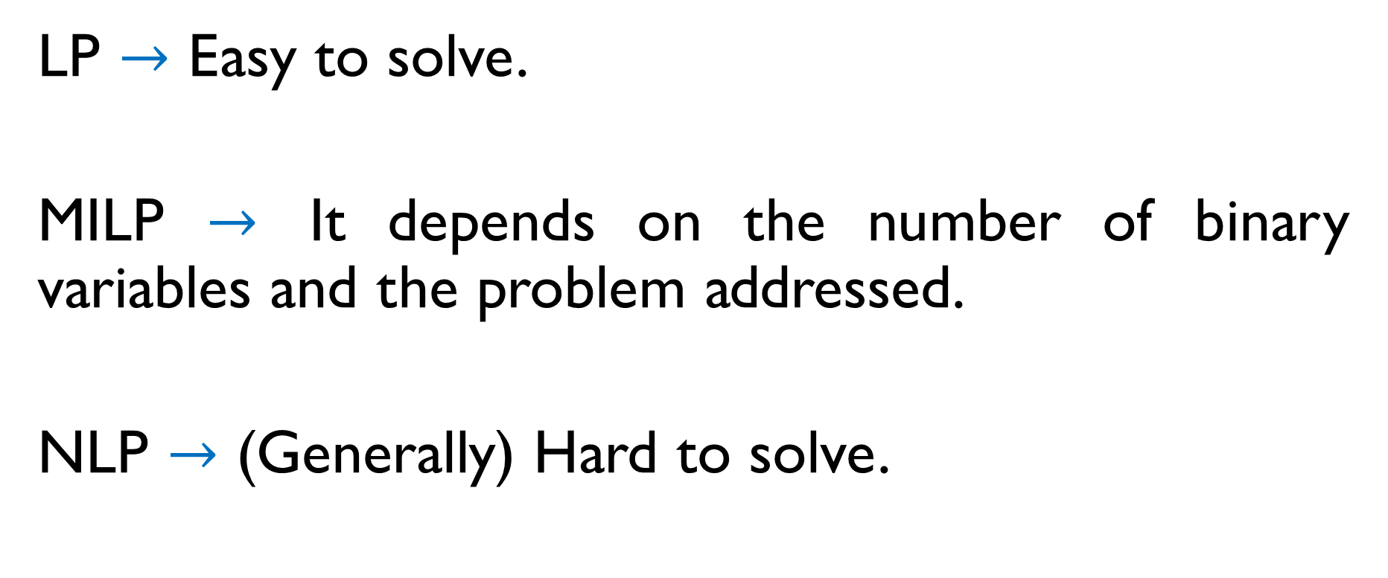
Classification of optimization problems
LP $→$ Easy to solve.
MILP $→$ It depends on the number of binary variables and the problem addressed.
NLP $→$ (Generally) Hard to solve.

Slide 26
Classification of optimization problems
M. Carrión, R. Domínguez, and G. Oggioni, “Optimal participation of wind power producers in a hybrid intraday market: a multi-stage stochastic approach”, Energy Economics, vol. 144, art. no. 108303, Apr. 2025, DOI: 10.1016/j.eneco.2025.108303.
LP problem:
Continuous variables: 3.8 million.
Constraints: 3.7 million.
Computational time: lower than 1 min.

Slide 27
Classification of optimization problems
Á. García-Cerezo, P. M. Drašković, and H. Pandžić, “Day-ahead market scheduling strategy of a virtual power plant under the single imbalance pricing scheme via stochastic robust optimization”, paper submitted to Energy Economics.
MILP problem:
Continuous variables: 14,337.
Integer variables: 1,008.
Constraints: 12,372.
Computational time: 3 min.

Slide 28
Classification of optimization problems
Á. García-Cerezo, A. Pleite-Paniagua, L. Baringo, and R. Domínguez, “Uncertainty-driven long-term participation of a virtual power plant in the day-ahead market and a grid-balancing demand response auction”, 24th Conference of the International Federation of Operational Research Societies (IFORS 2026), Vienna, Austria, Jul. 2026.
MILP problem:
Continuous variables: 1,329,631.
Integer variables: 129,990.
Constraints: 2,436,066.
Computational time: 1 h.

Slide 29
Classification of optimization problems
Á. García-Cerezo, R. García-Bertrand, and L. Baringo, “Computational performance enhancement strategies for risk-averse two-stage stochastic generation and transmission network expansion planning”, IEEE Transactions on Power Systems, vol. 39, no. 1, pp. 273–286, Jan. 2024, DOI: 10.1109/TPWRS.2023.3236397.
MILP problem:
Continuous variables: 1,544,135.
Integer variables: 272,017.
Constraints: 3,570,235.
Computational time: not solved after 168 h (1 week).

Slide 30
Classification of optimization problems
J. Muñoz Pedrosa, “Planning and operational decision-making for an industrial plant with self-consumption”, Bachelor’s Final Project, Electrical Engineering Degree, Universidad de Castilla-La Mancha, supervised by Á. García-Cerezo and M. Cañas-Carretón, Jul. 2026.
MINLP problem: not solved after 24 h (1 day).

Slide 31
Classification of optimization problems
Not all NLP and MINLP problems are hard to solve:
Model Type | Abbreviation | Terms | Variables
Mixed-Integer Quadratically Constrained Quadratic Programming | MIQCQP | Quadratic and linear | Integer and continuous

Slide 32
Classification of optimization problems
J. Muñoz Pedrosa, “Planning and operational decision-making for an industrial plant with self-consumption”, Bachelor’s Final Project, Electrical Engineering Degree, Universidad de Castilla-La Mancha, supervised by Á. García-Cerezo and M. Cañas-Carretón, Jul. 2026.
MINLP problem: not solved after 24 h (1 day).
MIQCQP problem: 3 min.
The optimization problem was THE SAME.
We only changed how the optimization problem was modeled.

Slide 33
Convexity
Convex problem
Nonconvex problem

Slide 34
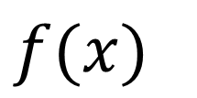

Convex function and set
$$f(x)$$
$$x$$

Slide 35
Nonconvex function and set
$$f(x)$$
$$x$$

Slide 36
Convexity
Convex set and convex function
https://www.youtube.com/watch?v=a_gRfwHUlhQ
Convexity and the principle of duality
https://www.youtube.com/watch?v=d0CF3d5aEGc

Slide 37
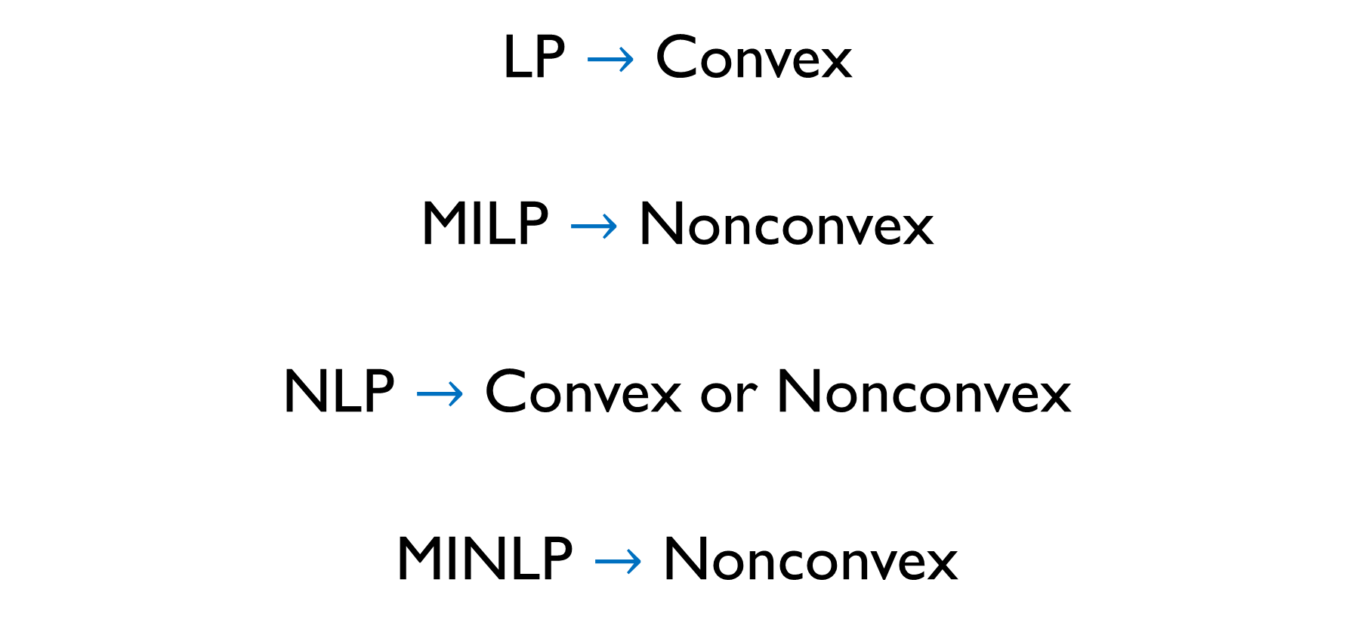
Convexity
LP $→$ Convex
MILP $→$ Nonconvex
NLP $→$ Convex or Nonconvex
MINLP $→$ Nonconvex

Slide 38
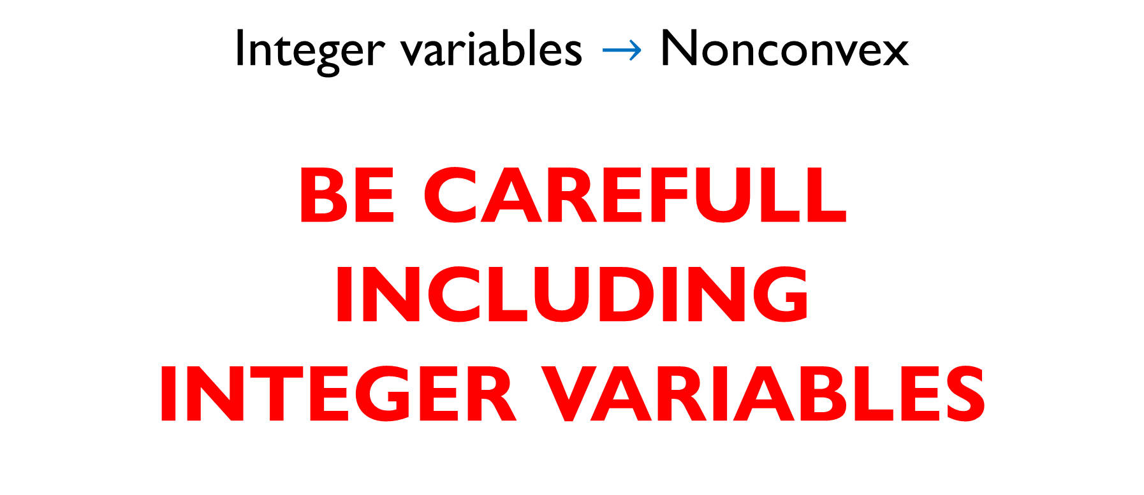
Convexity
Integer variables $→$ Nonconvex
BE CAREFULL
INCLUDING
INTEGER VARIABLES

Slide 39
High computational times
Sometimes the optimization problems cannot be directly solved due to the high computational burden.
We can:
Use approximation techniques (lecture 3).
Use decomposition techniques (lecture 4).

Slide 40
3. Linear Programming (LP)

Slide 41
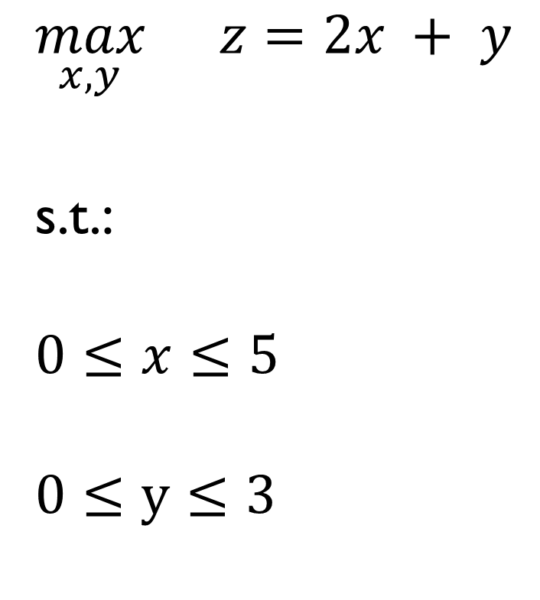
Example 1
$$\max_{x,y}{}z=2x + y$$
s.t.:
$$0≤x≤5$$
$$0≤y≤3$$

Slide 42
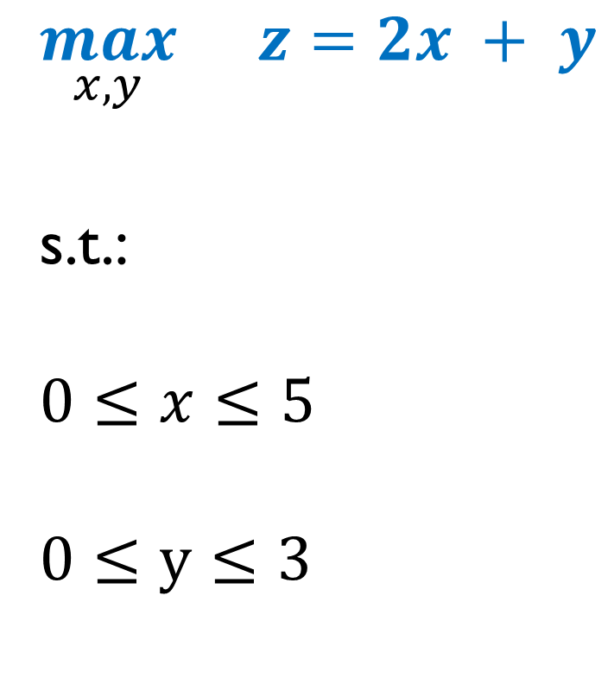
Example 1
$$\max_{x,y}{}z=2x + y$$
s.t.:
$$0≤x≤5$$
$$0≤y≤3$$
Objective function

Slide 43
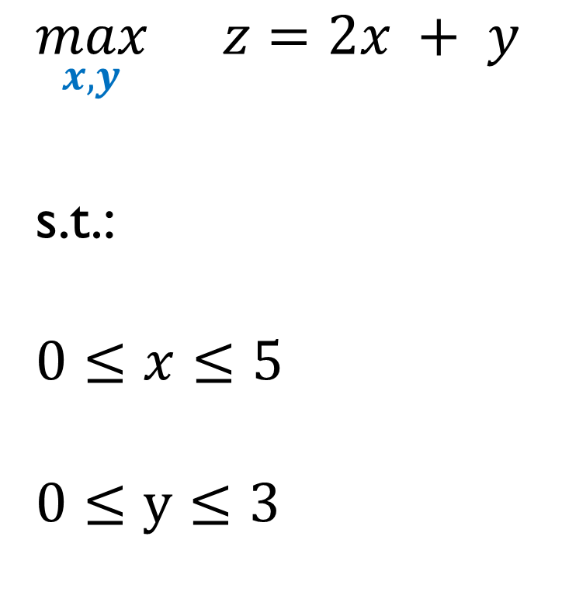
Example 1
$$\max_{x,y}{}z=2x + y$$
s.t.:
$$0≤x≤5$$
$$0≤y≤3$$
Variables (output data)

Slide 44
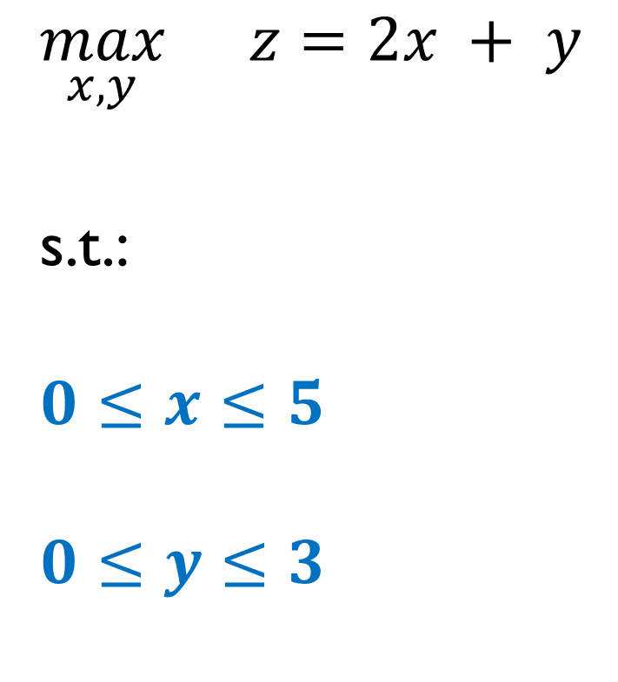
Example 1
$$\max_{x,y}{}z=2x + y$$
s.t.:
$$0≤x≤5$$
$$0≤y≤3$$
Constraints

Slide 45
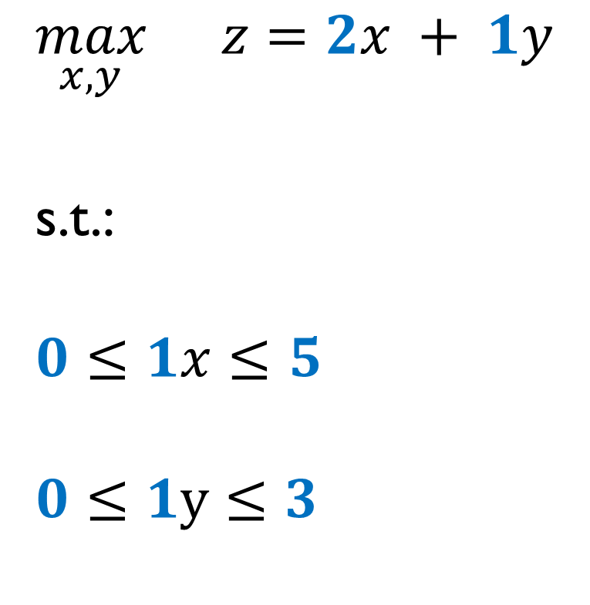
Example 1
$$\max_{x,y}{}z=2x + 1y$$
s.t.:
$$0≤1x≤5$$
$$0≤1y≤3$$
Parameters (input data)

Slide 46
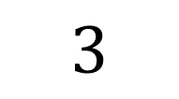
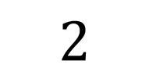
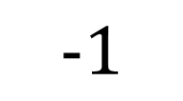
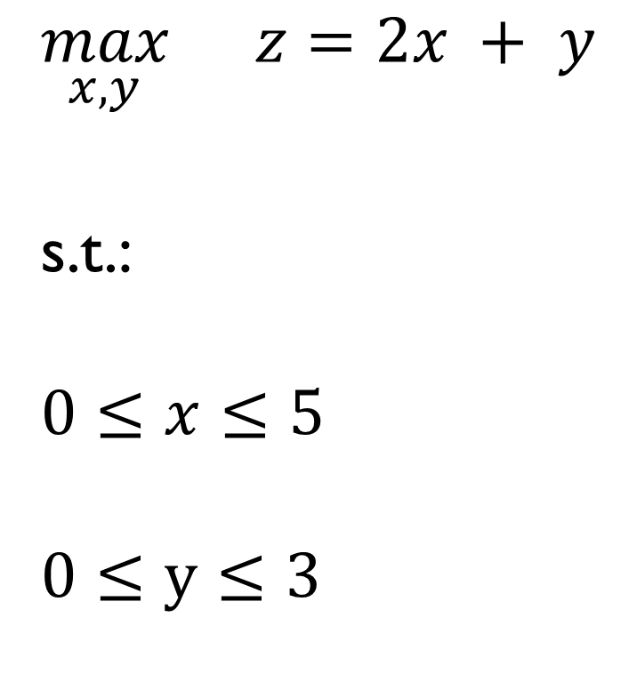
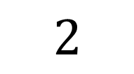

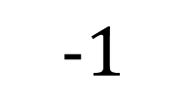
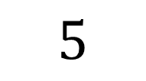
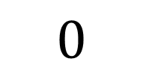
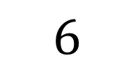

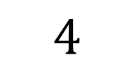
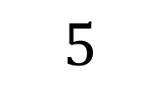

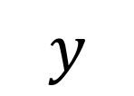
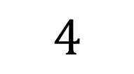
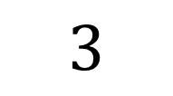
Example 1
$$y$$
$$\max_{x,y}{}z=2x + y$$
s.t.:
$$0≤x≤5$$
$$0≤y≤3$$
$$5$$
$$4$$
$$3$$
$$2$$
$$1$$
$$−1$$
$$0$$
$$1$$
$$2$$
$$3$$
$$4$$
$$5$$
$$6$$
$$x$$
$$−1$$

Slide 47
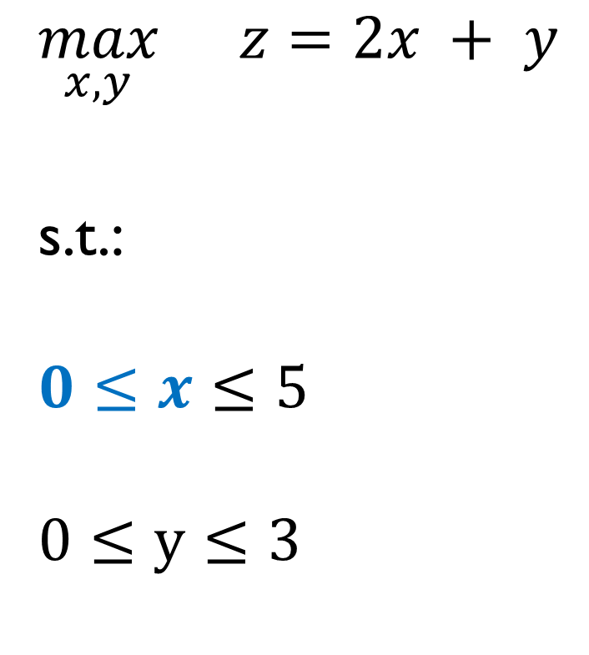
Example 1
$$y$$
$$\max_{x,y}{}z=2x + y$$
s.t.:
$$0≤x≤5$$
$$0≤y≤3$$
$$5$$
$$4$$
$$3$$
$$2$$
$$1$$
$$−1$$
$$0$$
$$1$$
$$2$$
$$3$$
$$4$$
$$5$$
$$6$$
$$x$$
$$−1$$

Slide 48
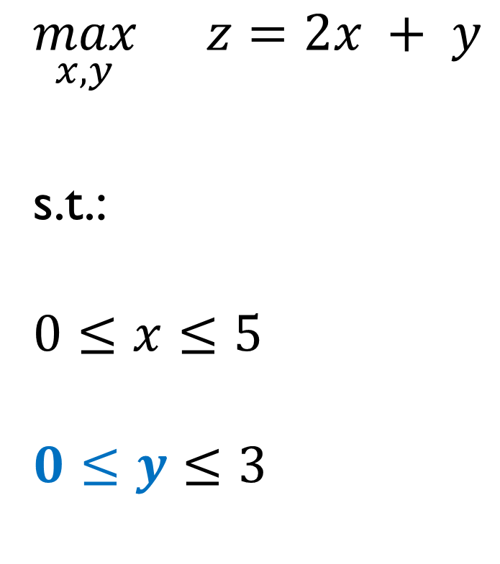
Example 1
$$y$$
$$\max_{x,y}{}z=2x + y$$
s.t.:
$$0≤x≤5$$
$$0≤y≤3$$
$$5$$
$$4$$
$$3$$
$$2$$
$$1$$
$$−1$$
$$0$$
$$1$$
$$2$$
$$3$$
$$4$$
$$5$$
$$6$$
$$x$$
$$−1$$

Slide 49
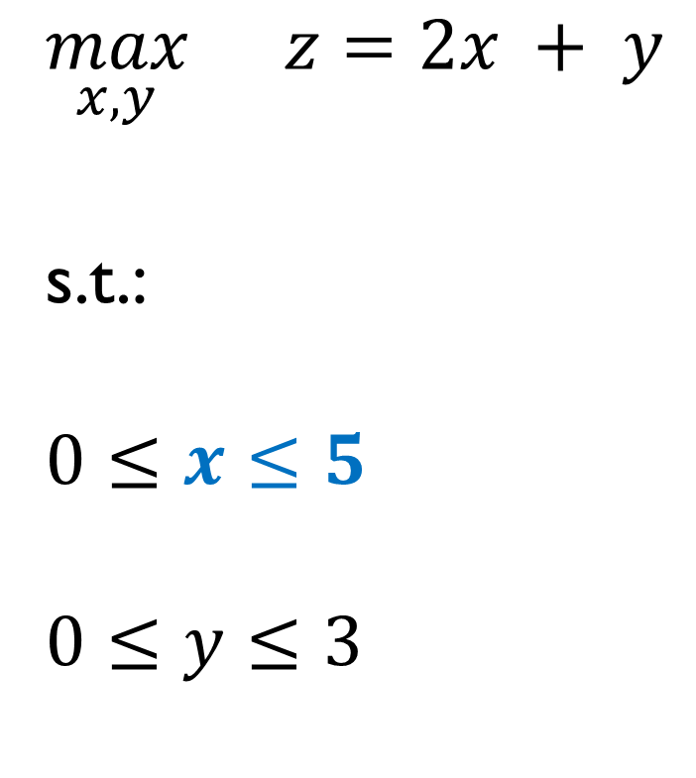
Example 1
$$y$$
$$\max_{x,y}{}z=2x + y$$
s.t.:
$$0≤x≤5$$
$$0≤y≤3$$
$$5$$
$$4$$
$$3$$
$$2$$
$$1$$
$$−1$$
$$0$$
$$1$$
$$2$$
$$3$$
$$4$$
$$5$$
$$6$$
$$x$$
$$−1$$

Slide 50
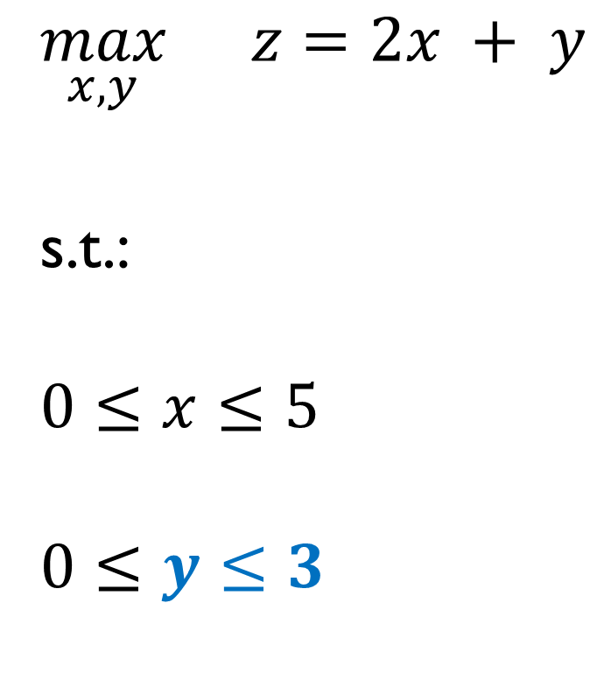
Example 1
$$y$$
$$\max_{x,y}{}z=2x + y$$
s.t.:
$$0≤x≤5$$
$$0≤y≤3$$
$$5$$
$$4$$
$$3$$
$$2$$
$$1$$
$$−1$$
$$0$$
$$1$$
$$2$$
$$3$$
$$4$$
$$5$$
$$6$$
$$x$$
$$−1$$

Slide 51
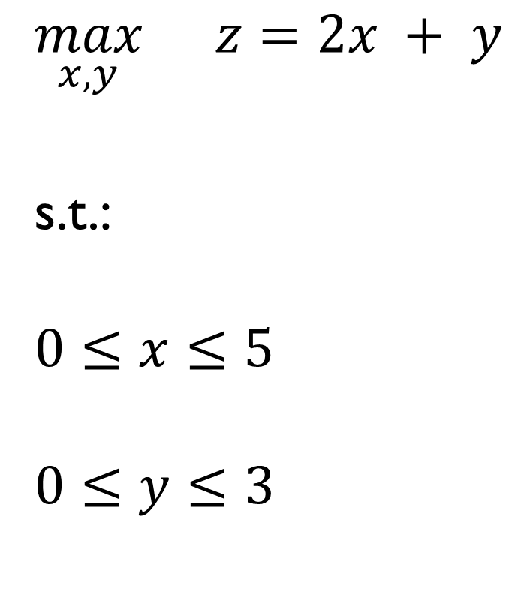
Example 1
Feasible region
$$y$$
$$\max_{x,y}{}z=2x + y$$
s.t.:
$$0≤x≤5$$
$$0≤y≤3$$
$$5$$
$$4$$
$$3$$
$$2$$
$$1$$
$$−1$$
$$0$$
$$1$$
$$2$$
$$3$$
$$4$$
$$5$$
$$6$$
$$x$$
$$−1$$

Slide 52
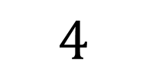
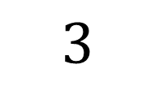

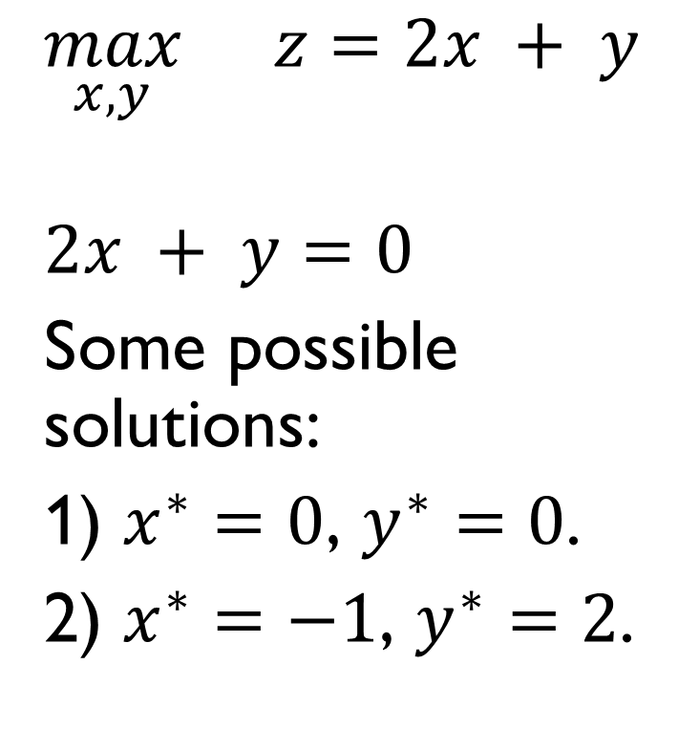
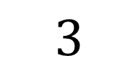
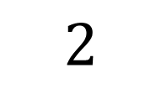
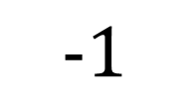
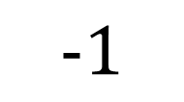
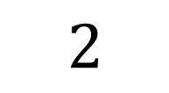

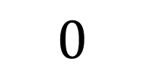






Example 1
$$y$$
$$\max_{x,y}{}z=2x + y$$
$$2x + y=0$$
Some possible solutions:
1) $x^{∗}=0$, $y^{∗}=0$.
2) $x^{∗}=−1$, $y^{∗}=2$.
$$5$$
$$4$$
$$3$$
$$2$$
$$1$$
$$−1$$
$$0$$
$$1$$
$$2$$
$$3$$
$$4$$
$$5$$
$$6$$
$$x$$
$$−1$$

Slide 53


Example 1
Objective function line associated with $z=0$
$$y$$
$$\max_{x,y}{}z=2x + y$$
Some possible solutions of $2x + y=0$:
1) $x^{∗}=0$, $y^{∗}=0$.
2) $x^{∗}=−1$, $y^{∗}=2$.
$$5$$
$$4$$
$$3$$
$$2$$
$$1$$
$$−1$$
$$0$$
$$1$$
$$2$$
$$3$$
$$4$$
$$5$$
$$6$$
$$x$$
$$−1$$

Slide 54



Example 1
$↑$ Objective function value $z$
$$y$$
$$\max_{x,y}{}z=2x + y$$
$$5$$
$$4$$
$$3$$
$$2$$
$$1$$
$↓$ Objective
function value $z$
$$−1$$
$$0$$
$$1$$
$$2$$
$$3$$
$$4$$
$$5$$
$$6$$
$$x$$
$$−1$$

Slide 55


















Example 1
$$y$$
$$z=2·0 + 3=3$$
$$\max_{x,y}{}z=2x + y$$
$$5$$
$$4$$
$$3$$
$$2$$
$$1$$
0
$$−1$$
$$0$$
$$1$$
$$2$$
$$3$$
$$4$$
$$5$$
$$6$$
$$x$$
$$−1$$

Slide 56


Example 1
$$y$$
$$z=2·5 + 0=10$$
$$\max_{x,y}{}z=2x + y$$
$$5$$
$$4$$
3
$$3$$
$$2$$
$$1$$
0
$$−1$$
$$0$$
$$1$$
$$2$$
$$3$$
$$4$$
$$5$$
$$6$$
$$x$$
$$−1$$

Slide 57


Example 1
$$y$$
$$z=2·5 + 3=13$$
$$\max_{x,y}{}z=2x + y$$
$$5$$
$$4$$
3
$$3$$
$$2$$
$$1$$
0
10
$$−1$$
$$0$$
$$1$$
$$2$$
$$3$$
$$4$$
$$5$$
$$6$$
$$x$$
$$−1$$

Slide 58

Example 1
$$y$$
$$\max_{x,y}{}z=2x + y$$
$$5$$
$$4$$
3
13
$$3$$
$$2$$
$$1$$
0
10
$$−1$$
$$0$$
$$1$$
$$2$$
$$3$$
$$4$$
$$5$$
$$6$$
$$x$$
$$−1$$

Slide 59

















Example 1
$$y$$
$$5$$
$$\max_{x,y}{}z=2x + y$$
Optimal solution:
$$x^{∗}=5$$
$$y^{∗}=3$$
$$z^{∗}=13$$
$$4$$
$$3$$
$$2$$
$$1$$
$$−1$$
$$0$$
$$1$$
$$2$$
$$3$$
$$4$$
$$5$$
$$6$$
$$x$$
$$−1$$

Slide 60
















Simplex Method
$$y$$
$$5$$
$$4$$
3
13
$$3$$
$$2$$
$$1$$
0
10
$$−1$$
$$0$$
$$1$$
$$2$$
$$3$$
$$4$$
$$5$$
$$6$$
$$x$$
$$−1$$

Slide 61
Simplex Method
Channel of Prof. Yong Wang (Binghamton University):
Basic Feasible Solution:
https://www.youtube.com/watch?v=0P5OAcXdUec
Graphical Explanation:
https://www.youtube.com/watch?v=Mz__0uBb2-U

Slide 62

Example 2
$$y$$
$$5$$
$$\min_{x,y}{}z=−\left(2x + y\right)$$
s.t.:
$$0≤x≤5$$
$$0≤y≤3$$
$$4$$
$$3$$
$$2$$
$$1$$
$$−1$$
$$0$$
$$1$$
$$2$$
$$3$$
$$4$$
$$5$$
$$6$$
$$x$$
$$−1$$

Slide 63

Example 2
$$y$$
$$5$$
$$\min_{x,y}{}z=−\left(2x + y\right)$$
s.t.:
$$0≤x≤5$$
$$0≤y≤3$$
Optimal solution:
$$x^{∗}=5$$
$$y^{∗}=3$$
$$z^{∗}=−13$$
$$4$$
$$3$$
$$2$$
$$1$$
$$−1$$
$$0$$
$$1$$
$$2$$
$$3$$
$$4$$
$$5$$
$$6$$
$$x$$
$$−1$$

Slide 64

Example 3
$$y$$
$$\max_{x,y}{}z=2x + y$$
s.t.:
$$0≤x$$
$$0≤y$$
$$5$$
$$4$$
$$3$$
$$2$$
$$1$$
$$−1$$
$$0$$
$$1$$
$$2$$
$$3$$
$$4$$
$$5$$
$$6$$
$$x$$
$$−1$$

Slide 65
Example 3
$$y$$
$$\max_{x,y}{}z=2x + y$$
s.t.:
$$0≤x$$
$$0≤y$$
$$5$$
$$4$$
$$3$$
$$2$$
$$1$$
$$−1$$
$$0$$
$$1$$
$$2$$
$$3$$
$$4$$
$$5$$
$$6$$
$$x$$
$$−1$$

Slide 66

Example 3
$$y$$
$$\max_{x,y}{}z=2x + y$$
s.t.:
$$0≤x$$
$$0≤y$$
Unbounded problem
$$5$$
$$4$$
$$3$$
$$2$$
$$1$$
$$−1$$
$$0$$
$$1$$
$$2$$
$$3$$
$$4$$
$$5$$
$$6$$
$$x$$
$$−1$$

Slide 67

Example 4
$$\max_{x,y}{}z=2x + y$$
s.t.:
$$0≤x≤5$$
$$0≤y≤3$$
$$4≤y$$

Slide 68
Example 4
$$y$$
$$\max_{x,y}{}z=2x + y$$
s.t.:
$$0≤x≤5$$
$$0≤y≤3$$
$$4≤y$$
$$5$$
$$4$$
$$3$$
$$2$$
$$1$$
$$−1$$
$$0$$
$$1$$
$$2$$
$$3$$
$$4$$
$$5$$
$$6$$
$$x$$
$$−1$$

Slide 69

Example 4
$$y$$
$$\max_{x,y}{}z=2x + y$$
s.t.:
$$0≤x≤5$$
$$0≤y≤3$$
$$4≤y$$
Infeasible problem
$$5$$
$$4$$
$$3$$
$$2$$
$$1$$
$$−1$$
$$0$$
$$1$$
$$2$$
$$3$$
$$4$$
$$5$$
$$6$$
$$x$$
$$−1$$

Slide 70

Example 5
$$y$$
$$\max_{x,y}{}z=2x + y$$
s.t.:
$$0≤x≤5$$
$$0≤y≤3$$
$$x+y≤4$$
$$5$$
$$4$$
$$3$$
$$2$$
$$1$$
$$−1$$
$$0$$
$$1$$
$$2$$
$$3$$
$$4$$
$$5$$
$$6$$
$$x$$
$$−1$$

Slide 71
Example 5
$$y$$
$$\max_{x,y}{}z=2x + y$$
s.t.:
$$0≤x≤5$$
$$0≤y≤3$$
$$x+y≤4$$
$$5$$
$$4$$
$$3$$
$$2$$
$$1$$
$$−1$$
$$0$$
$$1$$
$$2$$
$$3$$
$$4$$
$$5$$
$$6$$
$$x$$
$$−1$$

Slide 72
Example 5
$$y$$
$$\max_{x,y}{}z=2x + y$$
s.t.:
$$0≤x≤5$$
$$0≤y≤3$$
$$x+y≤4$$
$$5$$
$$4$$
$$3$$
$$2$$
$$1$$
$$−1$$
$$0$$
$$1$$
$$2$$
$$3$$
$$4$$
$$5$$
$$6$$
$$x$$
$$−1$$

Slide 73

Example 5
$$y$$
$$\max_{x,y}{}z=2x + y$$
s.t.:
$$0≤x≤5$$
$$0≤y≤3$$
$$x+y≤4$$
Optimal solution:
$$x^{∗}=4$$
$$y^{∗}=0$$
$$z^{∗}=8$$
$$5$$
$$4$$
$$3$$
$$2$$
$$1$$
$$−1$$
$$0$$
$$1$$
$$2$$
$$3$$
$$4$$
$$5$$
$$6$$
$$x$$
$$−1$$

Slide 74

Example 5
$$y$$
$$\max_{x,y}{}z=2x + y$$
s.t.:
$$0≤x≤5$$
$$0≤y≤3$$
$$x+y≤4$$
Inactive constraints (they do not influence the optimal solution)
$$5$$
$$4$$
$$3$$
$$2$$
$$1$$
$$−1$$
$$0$$
$$1$$
$$2$$
$$3$$
$$4$$
$$5$$
$$6$$
$$x$$
$$−1$$

Slide 75

Example 5
Example 1: $z=13$.
Example 5: $z=8$.
In a maximization/minimization problem, adding constraints leads to an objective function value lower/greater than or equal to the objective function value obtained without the additional constraints.

Slide 76

Example 6
$$y$$
$$\max_{x,y}{}z=2x + y$$
s.t.:
$$0≤x≤5$$
$$0≤y≤3$$
$$x+y≤4$$
$$x−y=1$$
$$5$$
$$4$$
$$3$$
$$2$$
$$1$$
$$−1$$
$$0$$
$$1$$
$$2$$
$$3$$
$$4$$
$$5$$
$$6$$
$$x$$
$$−1$$

Slide 77

Example 6
Feasible region
$$y$$
$$\max_{x,y}{}z=2x + y$$
s.t.:
$$0≤x≤5$$
$$0≤y≤3$$
$$x+y≤4$$
$$x−y=1$$
$$5$$
$$4$$
$$3$$
$$2$$
$$1$$
$$−1$$
$$0$$
$$1$$
$$2$$
$$3$$
$$4$$
$$5$$
$$6$$
$$x$$
$$−1$$

Slide 78
Example 6
$$y$$
$$\max_{x,y}{}z=2x + y$$
s.t.:
$$0≤x≤5$$
$$0≤y≤3$$
$$x+y≤4$$
$$x−y=1$$
$$5$$
$$4$$
$$3$$
$$2$$
$$1$$
$$−1$$
$$0$$
$$1$$
$$2$$
$$3$$
$$4$$
$$5$$
$$6$$
$$x$$
$$−1$$

Slide 79

Example 6
$$y$$
Optimal solution:
$$x^{∗}=2.5$$
$$y^{∗}=1.5$$
$$z^{∗}=6.5$$
$$5$$
$$4$$
$$3$$
$$2$$
$$1$$
$$−1$$
$$0$$
$$1$$
$$2$$
$$3$$
$$4$$
$$5$$
$$6$$
$$x$$
$$−1$$

Slide 80
4. Mixed-Integer Linear Programming (MILP)

Slide 81



Example 7
$$y$$
$$\max_{x,y}{}z=2x + y$$
s.t.:
$$0≤x≤5$$
$$1≤y≤3$$
$$x+y≤4$$
$$y∈ℕ$$
$$5$$
$$4$$
$$3$$
$$2$$
$$1$$
$$−1$$
$$0$$
$$1$$
$$2$$
$$3$$
$$4$$
$$5$$
$$6$$
$$x$$
$$−1$$

Slide 82

Example 7
$$y$$
$$\max_{x,y}{}z=2x + y$$
s.t.:
$$0≤x≤5$$
$$1≤y≤3$$
$$x+y≤4$$
$$y∈ℕ$$
$$5$$
$$4$$
$$3$$
$$2$$
$$1$$
$$−1$$
$$0$$
$$1$$
$$2$$
$$3$$
$$4$$
$$5$$
$$6$$
$$x$$
$$−1$$

Slide 83

Example 7
$$y$$
$$\max_{x,y}{}z=2x + y$$
s.t.:
$$0≤x≤5$$
$$1≤y≤3$$
$$x+y≤4$$
$$y∈ℕ$$
$$5$$
$$4$$
$$3$$
$$2$$
$$1$$
$$−1$$
$$0$$
$$1$$
$$2$$
$$3$$
$$4$$
$$5$$
$$6$$
$$x$$
$$−1$$

Slide 84
Example 7
$$y$$
$$\max_{x,y}{}z=2x + y$$
s.t.:
$$0≤x≤5$$
$$1≤y≤3$$
$$x+y≤4$$
$$y∈ℕ$$
$$5$$
$$4$$
$$3$$
$$2$$
$$1$$
$$−1$$
$$0$$
$$1$$
$$2$$
$$3$$
$$4$$
$$5$$
$$6$$
$$x$$
$$−1$$

Slide 85

Example 7
$$y$$
Optimal solution:
$$x^{∗}=3$$
$$y^{∗}=1$$
$$z^{∗}=7$$
$$5$$
$$4$$
$$3$$
$$2$$
$$1$$
$$−1$$
$$0$$
$$1$$
$$2$$
$$3$$
$$4$$
$$5$$
$$6$$
$$x$$
$$−1$$

Slide 86

Example 8
$$y$$
$$\max_{x,y}{}z=2x + y$$
s.t.:
$$0≤x≤2.5$$
$$1≤y≤3$$
$$x+y≤4$$
$$x,y∈ℕ$$
$$5$$
$$4$$
$$3$$
$$2$$
$$1$$
$$−1$$
$$0$$
$$1$$
$$2$$
$$3$$
$$4$$
$$5$$
$$6$$
$$x$$
$$−1$$

Slide 87

Example 8
$$y$$
$$\max_{x,y}{}z=2x + y$$
s.t.:
$$0≤x≤2.5$$
$$1≤y≤3$$
$$x+y≤4$$
$$x,y∈ℕ$$
$$5$$
$$4$$
$$3$$
$$2$$
$$1$$
$$−1$$
$$0$$
$$1$$
$$2$$
$$3$$
$$4$$
$$5$$
$$6$$
$$x$$
$$−1$$

Slide 88
Example 8
$$y$$
$$\max_{x,y}{}z=2x + y$$
s.t.:
$$0≤x≤2.5$$
$$1≤y≤3$$
$$x+y≤4$$
$$x,y∈ℕ$$
$$5$$
$$4$$
$$3$$
$$2$$
$$1$$
$$−1$$
$$0$$
$$1$$
$$2$$
$$3$$
$$4$$
$$5$$
$$6$$
$$x$$
$$−1$$

Slide 89

Example 8
$$y$$
Optimal solution:
$$x^{∗}=2$$
$$y^{∗}=2$$
$$z^{∗}=6$$
$$5$$
$$4$$
$$3$$
$$2$$
$$1$$
$$−1$$
$$0$$
$$1$$
$$2$$
$$3$$
$$4$$
$$5$$
$$6$$
$$x$$
$$−1$$

Slide 90

Branch and Bound
Algorithm based on the use of a relaxed formulation.
Integer variables $→$ Continuous variables.
Iterative procedure $→$ All the search tree is analyzed or the optimality GAP condition is fulfilled: if $UB−LB>GAP$, continue; otherwise, stop.
A relative optimality GAP condition can also be considered: if $\frac{\left|UB−LB\right|}{\left|LB\right|}>GAP$, continue; otherwise, stop.

Slide 91

Branch and Bound
If $GAP>0$, we cannot claim that the solution found is the global optimum.
However, the solution may be good enough for the decision maker.
https://www.youtube.com/watch?v=tBUfL3O_Nzg

Slide 92
5. Nonlinear Programming
(NLP)

Slide 93

Example 9
$$y$$
$$\max_{x,y}{}z=2x + y$$
s.t.:
$$0≤x$$
$$0≤y$$
$4≤x^{2}+y^{2}$ $≤9$
$$5$$
$$4$$
$$3$$
$$2$$
$$1$$
$$−1$$
$$0$$
$$1$$
$$2$$
$$3$$
$$4$$
$$5$$
$$6$$
$$x$$
$$−1$$

Slide 94

Example 9
$$y$$
$$\max_{x,y}{}z=2x + y$$
s.t.:
$$0≤x$$
$$0≤y$$
$4≤x^{2}+y^{2}$ $≤9$
$$5$$
$$4$$
$$3$$
$$2$$
$$1$$
$$−1$$
$$0$$
$$1$$
$$2$$
$$3$$
$$4$$
$$5$$
$$6$$
$$x$$
$$−1$$

Slide 95

Example 9
$$y$$
Optimal solution:
$$x^{∗}=2.683$$
$$y^{∗}=1\text{.}3462$$
$$z^{∗}=6.708$$
$$5$$
$$4$$
$$3$$
$$2$$
$$1$$
$$−1$$
$$0$$
$$1$$
$$2$$
$$3$$
$$4$$
$$5$$
$$6$$
$$x$$
$$−1$$

Slide 96

Example 10
$$y$$
$$\max_{x,y}{}z=2x + y$$
s.t.:
$$1≤x≤5$$
$$1≤y≤3$$
$$y\left(x−1\right)≤x$$
$$5$$
$$4$$
$$3$$
$$2$$
$$1$$
$$−1$$
$$0$$
$$1$$
$$2$$
$$3$$
$$4$$
$$5$$
$$6$$
$$x$$
$$−1$$

Slide 97
Example 10
$$y$$
$$\max_{x,y}{}z=2x + y$$
s.t.:
$$1≤x≤5$$
$$1≤y≤3$$
$$y\left(x−1\right)≤x$$
$$5$$
$$4$$
$$3$$
$$2$$
$$1$$
$$−1$$
$$0$$
$$1$$
$$2$$
$$3$$
$$4$$
$$5$$
$$6$$
$$x$$
$$−1$$

Slide 98

Example 10
$$y$$
Optimal solution:
$$x^{∗}=5$$
$$y^{∗}=1.25$$
$$z^{∗}=11.25$$
$$5$$
$$4$$
$$3$$
$$2$$
$$1$$
$$−1$$
$$0$$
$$1$$
$$2$$
$$3$$
$$4$$
$$5$$
$$6$$
$$x$$
$$−1$$

Slide 99
6. Optimization Software

Slide 100
Optimization Software
GAMS: General Algebraic Modeling System.
Pyomo.
AMPL.
AIMMS.
JuMP.
…

Slide 101

GAMS
Get started:
https://www.gams.com/free-licenses/#get-started
Download:
https://www.gams.com/download/
Documentation:
https://www.gams.com/latest/docs/index.html

Slide 102
Solvers
Gurobi.
IBM CPLEX
CONOPT.
MOSEK.
KNITRO.
…

Slide 103


Exercise 1
$$\max_{x,y}{}z=2x + y$$
s.t.:
$$0≤x≤5$$
$$0≤y≤3$$
$$x+y≤4$$
Optimal solution:
$$x^{∗}=4$$
$$y^{∗}=0$$
$$z^{∗}=8$$

Slide 104


Exercise 2
$$\max_{x,y}{}z=2x + y$$
s.t.:
$$0≤x≤2.5$$
$$1≤y≤3$$
$$x+y≤4.7$$
$$x,y∈ℕ$$
Optimal solution:
$$x^{∗}=2$$
$$y^{∗}=2$$
$$z^{∗}=6$$

Slide 105


Exercise 3
$$\max_{x,y}{}z=2x + y$$
s.t.:
$$0≤x$$
$$0≤y$$
$1≤x^{2}+y^{2}$ $≤9$
Optimal solution:
$$x^{∗}=2.683$$
$$y^{∗}=1\text{.}342$$
$$z^{∗}=6.708$$

Slide 106


Exercise 4
$$\max_{x,y}{}z=2x + y$$
s.t.:
$$1≤x≤5$$
$$1≤y≤3$$
$$y\left(x−1\right)≤x$$
Optimal solution:
$$x^{∗}=5$$
$$y^{∗}=1.25$$
$$z^{∗}=11.25$$

Slide 107


Exercise 5
$$\min_{x}{}z=−2x_{1}−x_{2}+4x_{3}+x_{4}$$
s.t.:
$x_{1}$, $x_{2}$, $x_{3}$, $x_{4}≥0$
$$x_{1}≤4$$
$$x_{2}≤3$$
$$x_{3}≤5$$
$$x_{4}≤1$$
$$x_{1}+x_{2}+x_{3}+x_{4}=10$$
Optimal solution:
$$x_{1}^{∗}=4$$
$$x_{2}^{∗}=3$$
$$x_{3}^{∗}=2$$
$$x_{4}^{∗}=1$$
$$z^{∗}=−2$$

Slide 108

Notation
I will use the following notation in the course:
Uppercase letters $→$ Parameters (input data).
Lowercase letters $→$ Variables (output data).

Slide 109


Exercise 6 – Compact formulation
$$\min_{x}{}z=\sum_{i=1}^{I}{A_{i}x_{i}}$$
s.t.:
$0≤x_{i}≤{\overline{X}}_{i}$, $i=1,…,I$
$$\sum_{i=1}^{I}{x_{i}}=B$$
$$A=\left[−2,−1, 4, 1\right].$$
$$\overline{X}=\left[4, 3, 5, 1\right].$$
$$B=10.$$
Optimal solution:
$$x_{1}^{∗}=4$$
$$x_{2}^{∗}=3$$
$$x_{3}^{∗}=2$$
$$x_{4}^{∗}=1$$
$$z^{∗}=−2$$

Slide 110

Exercise 7 – Sensitivity analysis
Solve exercise 6 for the following values of parameter $B$: 0, 3, 8, 12, and 21. Use the LOOP statement in GAMS.
Solution:
$B=0→z^{∗}=0.$
$B=3→z^{∗}=−6.$
$B=8→z^{∗}=−10.$
$B=12→z^{∗}=6.$
$B=21→z^{∗}=6$ (INFEASIBLE) $→$ Check the solution report.

Slide 111
7. Dual variables

Slide 112

Dual variables
$$\min_{x}{}z=f(x)$$
s.t.:
$$h\left(x\right)=0 :λ$$
$$g\left(x\right)≤0:μ$$
Dual variables

Slide 113
Dual variables
Channel of Prof. Michel Bierlaire (École Polytechnique Fédérale de Lausanne):
Duality: duality in linear optimization
https://www.youtube.com/watch?v=R3Z1fRXXxyg
Duality: Lagrangian and dual problem
https://www.youtube.com/watch?v=4OifjG2kIJQ

Slide 114
Formulation
I will consider hourly time periods for the sake of simplicity.
Hence, power (MW) and energy (MWh) units are equivalent.
If this is not the case, the duration of the time periods should be included in the formulation.

Slide 115
Day-ahead electricity market
Demand
Price (€/MWh)
Power (MW)

Slide 116
Day-ahead electricity market
Supply
Price (€/MWh)
Power (MW)

Slide 117


Day-ahead electricity market
Price (€/MWh)
$$λ^{∗}$$
$$p^{∗}$$
Power (MW)

Slide 118

Day-ahead electricity market

Slide 119
Day-ahead electricity market
Consumer Surplus
Price (€/MWh)
Power (MW)

Slide 120
Day-ahead electricity market
Producer Surplus
Price (€/MWh)
Power (MW)

Slide 121
Day-ahead electricity market
Social Welfare
Price (€/MWh)
Power (MW)

Slide 122
Day-ahead electricity market
Price (€/MWh)
Power (MW)

Slide 123
Day-ahead electricity market
Price (€/MWh)
Power (MW)

Slide 124

Day-ahead electricity market
$$\max_{} = −$$
s.t.:
Demand $−$ Supply $=0 :λ$
Constraints of the bids and offers
Price (€/MWh)
Power (MW)

Slide 125


Day-ahead electricity market
$$\max_{} = −$$
s.t.:
Demand $−$ Supply $=0 :λ$
Constraints of the bids and offers
Price (€/MWh)
$$λ^{∗}$$
$$p^{∗}$$
Power (MW)

Slide 126
Exercise 8 – Day-ahead electricity market
Consumer 1
Bid 1: 240 MW, €25/MWh.
Bid 2: 180 MW, €23/MWh.
Consumer 2
Bid 1: 147 MW, €19/MWh.
Bid 2: 110 MW, €18/MWh.

Slide 127
Exercise 8 – Day-ahead electricity market
Producer 1
Offer 1: 217 MW, €18/MWh.
Offer 2: 200 MW, €20/MWh.
Producer 2
Offer 1: 220 MW, €21/MWh.
Offer 2: 250 MW, €25/MWh.

Slide 128

Exercise 8 – Day-ahead electricity market
Determine the optimal solution of the day-ahead electricity market.
Solution:
Social Welfare $=$ €2171.
$p^{∗}=$420 MW.
$λ^{∗}=$ €21/MWh.

Slide 129
8. Reformulation Techniques

Slide 130
Reformulation techniques
This section presents some reformulation techniques that I have used during my previous works:
Slack variables.
Product of two binary variables.
Product of continuous and binary variables.
Absolute value.
Square root.

Slide 131

Slack variables
$$\min_{x,y}{}z=f\left(x,y\right)$$
s.t.:
$$0≤x≤10$$
$$0≤y≤10$$
$$x+y=25$$
Infeasible problem

Slide 132


Slack variables
$$\min_{x,y,w}{}z=Ax+By+Cw$$
s.t.:
$$0≤x≤10$$
$$0≤y≤10$$
$$x+y+w=25$$
where $C$ is a large constant such that $C>A$ and $C>B.$
Optimal solution:
$$x^{∗}=10$$
$$y^{∗}=10$$
$$w^{∗}=5$$

Slide 133
Slack variables
The use of slack variables is useful for example in transmission network expansion planning problems.
If the candidate transmission lines are not sufficient to satisfy the demand, then the slack variables are different from 0. Hence, the optimization problem must be solved again considering additional candidate transmission lines to ensure the feasibility of the problem, i.e., satisfy the demand.

Slide 134

Product of two binary variables – Case 1
$$\min_{a,b,x,y}{}z=f\left(x,y\right)$$
s.t.:
$$\underline{X}≤x≤\overline{X}$$
$$\underline{Y}≤y≤\overline{Y}$$
$$a,b∈\left\{0, 1\right\}$$
$$g(x,y)≤Dab$$
Nonlinear term: $ab$

Slide 135


Product of two binary variables – Case 1
$$\min_{a,b,x,y}{}z=f\left(x,y\right)$$
s.t.:
$$\underline{X}≤x≤\overline{X}$$
$$\underline{Y}≤y≤\overline{Y}$$
$$a,b∈\left\{0, 1\right\}$$
$$g(x,y)≤Dab$$
Nonlinear term: $ab$
$$\min_{a,b,x,y}{}z=f\left(x,y\right)$$
s.t.:
$$\underline{X}≤x≤\overline{X}$$
$$\underline{Y}≤y≤\overline{Y}$$
$$a,b∈\left\{0, 1\right\}$$
$$g(x,y)≤Da$$
$$g(x,y)≤Db$$

Slide 136

Product of two binary variables – Case 1
$$a$$ | $$b$$ | $$g(x,y)≤Da$$ | $$g(x,y)≤Db$$ | Result
$$0$$ | $$0$$ | $$g(x,y)≤0$$ | $$g(x,y)≤0$$ | $$g(x,y)≤0$$
$$0$$ | $$1$$ | $$g(x,y)≤0$$ | $$g(x,y)≤D$$ | $$g(x,y)≤0$$
$$1$$ | $$0$$ | $$g(x,y)≤D$$ | $$g(x,y)≤0$$ | $$g(x,y)≤0$$
$$1$$ | $$1$$ | $$g(x,y)≤D$$ | $$g(x,y)≤D$$ | $$g(x,y)≤D$$

Slide 137

Product of two binary variables – Case 2
$$\min_{a,b,x,y}{}z=f\left(x,y\right)$$
s.t.:
$$\underline{X}≤x≤\overline{X}$$
$$\underline{Y}≤y≤\overline{Y}$$
$$a,b∈\left\{0, 1\right\}$$
$$h\left(x,y\right)=Dab$$
Nonlinear term: $ab$

Slide 138

Product of two binary variables – Case 2
We cannot replace $h\left(x,y\right)=Dab$ with $h\left(x,y\right)=Da$ and $h\left(x,y\right)=Db$.
Try it if you do not believe me.

Slide 139

Product of two binary variables – Case 2
$$\min_{a,b,x,y}{}z=f\left(x,y\right)$$
s.t.:
$$\underline{X}≤x≤\overline{X}$$
$$\underline{Y}≤y≤\overline{Y}$$
$$a,b∈\left\{0, 1\right\}$$
$$h\left(x,y\right)=Dab$$
Nonlinear term: $ab$
$$\min_{a,b,c,x,y,}{}z=f\left(x,y\right)$$
s.t.:
$$\underline{X}≤x≤\overline{X}$$
$$\underline{Y}≤y≤\overline{Y}$$
$$a,b∈\left\{0, 1\right\}$$
$$h\left(x,y\right)=Dc$$
$$c≤a$$
$$c≤b$$
$$c≥a+b−1, c≥0$$

Slide 140


Product of two binary variables – Case 2
$$a$$ | $$b$$ | $$c≤a$$ | $$c≤b$$ | $$c≥a+b−1$$ | $$c$$
$$0$$ | $$0$$ | $$c≤0$$ | $$c≤0$$ | $$c≥−1^{∗}$$ | $$0$$
$$0$$ | $$1$$ | $$c≤0$$ | $$c≤1$$ | $$c≥0$$ | $$0$$
$$1$$ | $$0$$ | $$c≤1$$ | $$c≤0$$ | $$c≥0$$ | $$0$$
$$1$$ | $$1$$ | $$c≤1$$ | $$c≤1$$ | $$c≥1$$ | $$1$$
${}^{∗}$Note that $c≥0$.

Slide 141

Product of continuous and binary variables
$$\min_{x,y}{}z=f\left(x,y\right)$$
s.t.:
$$\underline{X}≤x≤\overline{X}$$
$$y∈\left\{0, 1\right\}$$
$$g\left(x,y\right)≤Axy$$
Nonlinear term: $xy$

Slide 142
Product of continuous and binary variables
Disjunctive linearization
&
Big M method

Slide 143

Product of continuous and binary variables
$$\min_{x,y}{}z=f\left(x,y\right)$$
s.t.:
$$\underline{X}≤x≤\overline{X}$$
$$y∈\left\{0, 1\right\}$$
$$g\left(x,y\right)≤Axy$$
Nonlinear term: $xy$
$$\min_{x,y,w}{}z=f\left(x,y\right)$$
s.t.:
$$\underline{X}≤x≤\overline{X}$$
$$y∈\left\{0, 1\right\}$$
$$g\left(x,y\right)≤Aw$$
$$−My≤w≤My$$
$$−M\left(1−y\right)≤x−w≤M\left(1−y\right)$$
where $M$ is a large constant$.$

Slide 144

Product of continuous and binary variables
If $y=1$:
$$−M\left(1−1\right)≤x−w≤M\left(1−1\right)→0≤x−w≤0→$$
$$→x−w=0→w=x$$
$−M·1≤w≤M·1→$ $−M≤w≤M$
Note that $−M≤w≤M$ and $w=x$, i.e., $−M≤x≤M$.
The value of $M$ must be selected such that $−M≤x≤M$ is not more restrictive than $\underline{X}≤x≤\overline{X}$.
Different $M$’s can be used for upper and lower limits.

Slide 145

Product of continuous and binary variables
If $y=0$:
$−M·0≤w≤M·0→$ $−0≤w≤0→w=0$
$$−M\left(1−0\right)≤x−0≤M\left(1−0\right)→−M≤x≤M$$
As mentioned before:
The value of $M$ must be selected such that $−M≤x≤M$ is not more restrictive than $\underline{X}≤x≤\overline{X}$.
Different $M$’s can be used for upper and lower limits.

Slide 146

Product of continuous and binary variables
If $y=1$, then $w=x$.
If $y=0$, then $w=0$.
This means that $w=xy$.

Slide 147

Product of continuous and binary variables
Additional comments:
Very large values of $M$ may lead to computational issues.
Constraints associated with $M$ must be checked ex post $→$ Trial-and-error method.
The proper values of $M$ can be known in some cases (see next slide).

Slide 148

Product of continuous and binary variables
$$\min_{x,y,w}{}z=f\left(x,y\right)$$
s.t.:
$$\underline{X}≤x≤\overline{X}$$
$$y∈\left\{0, 1\right\}$$
$$g\left(x,y\right)≤Aw$$
$$\underline{X}y≤w≤\overline{X}y$$
$$\underline{X}\left(1−y\right)≤x−w≤\overline{X}\left(1−y\right)$$

Slide 149

Product of two continuous variables
Nonlinear term: $xy$ in the objective function, an equality constraint or an inequality constraint.
We can discretize one of the continuous variables.
This approach is an approximation, not an exact reformulation!

Slide 150

Product of two continuous variables
For example, we can consider some discrete values of one of the continuous variables:
$$x={X_{1}u}_{1}+{X_{2}u}_{2}+{X_{1}u}_{1}+{X_{3}u}_{3}$$
$$u_{1}+u_{2}+u_{3}=1$$
$$u_{1},u_{2},u_{3}∈\left\{0, 1\right\}$$
Then, $xy={X_{1}u}_{1}y+{X_{2}u}_{2}y+{X_{1}u}_{1}y+{X_{3}u}_{3}y$. The nonlinear terms $u_{i}y$ of binary and continuous variables can be linearized as explained before.

Slide 151

Product of two continuous variables
We can also use a binary expansion linearization (approximation):
$$x=\underline{X}+\left(\overline{X}−\underline{X}\right)\sum_{k=1}^{K}{2^{−k}u_{k}}$$
$$u_{k}∈\left\{0, 1\right\}, k=1,…,K$$

Slide 152

Absolute value
$$\min_{x,y,w}{}z=f\left(x,y\right)+D\left|w\right|$$
s.t.:
$$\underline{X}≤x≤\overline{X}$$
$$\underline{Y}≤y≤\overline{Y}$$
$$\underline{W}≤w≤\overline{W}$$
$$g\left(x,y\right)≤C\left|w\right|$$
Nonlinear term: $\left|w\right|$

Slide 153

Absolute value
$\min_{a,b,x,y,w}{}z=f\left(x,y\right)$ $+Da$
s.t.:
$$\underline{X}≤x≤\overline{X}$$
$$\underline{Y}≤y≤\overline{Y}$$
$$\underline{W}≤w≤\overline{W}$$
$$g\left(x,y\right)≤Ca$$
$$b∈\left\{0,1\right\}$$
$$0≤a−w≤M\left(1−b\right)$$
$$0≤a+w≤Mb$$
$$\min_{x,y,w}{}z=f\left(x,y\right)+D\left|w\right|$$
s.t.:
$$\underline{X}≤x≤\overline{X}$$
$$\underline{Y}≤y≤\overline{Y}$$
$$\underline{W}≤w≤\overline{W}$$
$$g\left(x,y\right)≤C\left|w\right|$$
Nonlinear term: $\left|w\right|$

Slide 154

Absolute value
If $b=1$:
$$0≤a−w≤M\left(1−1\right)→0≤a−w≤0→a=w$$
$$0≤a+w≤M·1→0≤a+w≤M→$$
$$→0≤2w≤M→0≤w≤M/2$$
Can $w$ be $<0?0≤w≤M/2→$ Not possible
Can $w$ be $>0?0≤w≤M/2→$ OK
Then, $b=1$ if $w>0$.

Slide 155

Absolute value
If $b=0$:
$$0≤a+w≤M·0→0≤a+w≤0→a=−w$$
$$0≤a−w≤M\left(1−0\right)→0≤a−w≤M→$$
$$→0≤−2w≤M→−M≤2w≤0→−M/2≤w≤0$$
Can $w$ be $>0?$ $−M/2≤w≤0→$ Not possible
Can $w$ be $<0?$ $−M/2≤w≤0→$ OK
Then, $b=0$ if $w<0$.

Slide 156

Absolute value
If $w>0$, then $a=w$.
If $w<0$, then $a=−w$.
This means that $a=\left|w\right|$.

Slide 157

Square root
$$\min_{x,y}{}z=f\left(x,y\right)+\sqrt{x^{2}+y^{2}}$$
s.t.:
$$h\left(x,y\right)=0$$
$$g\left(x,y\right)≤0$$
Nonlinear term: $\sqrt{x^{2}+y^{2}}$
This is an NLP problem.

Slide 158

Square root
$$\min_{x,y}{}z=f\left(x,y\right)+\sqrt{x^{2}+y^{2}}$$
s.t.:
$$h\left(x,y\right)=0$$
$$g\left(x,y\right)≤0$$
Nonlinear term: $\sqrt{x^{2}+y^{2}}$
This is an NLP problem.
$$\min_{x,y,w}{}z=f\left(x,y\right)+w$$
s.t.:
$$h\left(x,y\right)=0$$
$$g\left(x,y\right)≤0$$
$$x^{2}+y^{2}≤w^{2}$$
$$w≥0$$
Nonlinear terms: $x^{2}$, $y^{2}$, and $w^{2}$.
This is a QCQP problem.

Slide 159

Square root
The constraint $x^{2}+y^{2}≤w^{2}$ acts as $x^{2}+y^{2}=w^{2}$ in practice because $w$ is considered in the objective function (minimization problem). Hence, $w=±\sqrt{x^{2}+y^{2}}$.
Moreover, constraint $w≥0$ should be considered to prevent the solution $w=−\sqrt{x^{2}+y^{2}}$.
Therefore, the solution is $w=+\sqrt{x^{2}+y^{2}}$.

Slide 160
Next lecture
Lecture 1: Introduction to operations research.
Lecture 2: Operation and planning problems.
Lecture 3: Operational variability.
Lecture 4: Uncertainty and risk.
Lecture 5: Further applications.

Slide 161

References
A. J. Conejo, E. Castillo, R. Mínguez, and R. García-Bertrand, Decomposition Techniques in Mathematical Programming: Engineering and Science Applications. Springer-Verlag, Berlin, 2006. ISBN: 3-540-27685-8. DOI: 10.1007/3-540-27686-6.

Slide 162

References
A. J. Conejo and L. Baringo, Power System Operations. Springer, Cham, Switzerland, 2018. ISBN: 978-3-319-69406-1. DOI: 10.1007/978-3-319-69407-8.

Slide 163

References
A. DeJeans Jr., The MILP Optimization Handbook: An Introduction to Linear and Integer Programming for Practitioners. BITBROS, 2025. ISBN: 979-8296430359.

Slide 164

References
A. DeJeans Jr., The Linearization Handbook for MILP Optimization: Modeling Tricks and Patterns for Practitioners. BITBROS, 2025. ISBN: 979-8293657544.

Slide 165
Thank you very much for your attention!
Contact: Alvaro.GarciaCerezo@uclm.es
Álvaro García-Cerezo
Power and Energy Analysis and Research Laboratory
School of Industrial and Aerospace Engineering of Toledo, Spain
Universidad de Castilla-La Mancha, Spain

